Slide 1
Software Engineering
CS20006
Lecture 16
Design Tools and Techniques
(Part-II)

Slide 2
Entity Relationship Diagram

Slide 3
Basic Concepts and Notations on
Entity Relationship Diagram

Slide 4
What is an ERD?
An Entity Relationship Diagram (ERD) is a graphical representation of an organization’s data storage requirements
ERDs are abstractions of the real world, which simplify the problem to be solved while retaining its essential features

Slide 5
Why ERD?
Entity relationship diagrams are used to
  Identify the data that must be captured, stored and retrieved in order to support the activities performed by an organization
  A major data modeling tool and help to organize the data in the project into entities and define the relationship between entities
  It enables the analyst to produce a good database structure so that the data can be stored and retrieved in a most efficient manner

Slide 6
Composition of ERD
Entity relationship diagrams have three components
  Entities
  Attributes
  Relationships

Slide 7
Entity in ERD
Entities
  An entity is anything real or abstract about which we want to store data. In short, anything, which an organization needs to store data about
  Entity types fall into five classes
    Roles
      e.g. Employee, Student
    Events
      e.g. Payment, Borrow
    Locations
      e.g. Campus, City
    Tangible things or concepts
      e.g. Department, Book

Slide 8
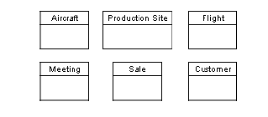
Representation Entity
Entities
  Entities are represented on the diagram by labeled boxes

Slide 9
Entity Sub-type
Entities
  Sometimes it is useful to generalize a group of entities
  Example
  CAR, SHIP and AEROPLANE all are type of VEHICLE

Slide 10
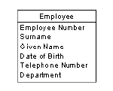
Attributes in ERD
Attributes
  Entities are further described by their attributes (also called data elements)
  Theses are the smallest units of data that can be described in a meaningful manner
  Example: An EMPLOYEE entity may the following attributes

Slide 11
Relationships in ERD
Relationships
  A data relationship is a natural association that exist between one or more entities
  Example
  EMPLOYEE works in DEPARTMENT
  EQUIPMENT is allocated to PROJECT
  ESTEEM is a type of CAR

Slide 12
One-to-one Relationships
Three types of relationship exist between two different entities
It is also called the cardinality (the number of occurrences of one entity for a single occurrence of the related entity)
  One-to-one relationship
  One-to-many relationship
  Many-to-many relationship

Slide 13
One-to-one Relationships
This type of relationship takes place when a single occurrence of an entity is related to just one occurrence of a second entity
Example:
PERSON owns a CAR
CAR is owned by a PERSON

Slide 14
One-to-many Relationships
This type of relationship takes place when a single occurrence of an entity is related to many occurrence of a second entity
Example:
DEPARTMENT has EMPLOYEE
EMPLOYEE works in DEPARMENT

Slide 15
Many-to-many Relationships
This type of relationship takes place when many occurrence of an entity are related to many occurrence of a second entity
Example:
STAFF work in PROJECT
PROJECT assigned to STAFF

Slide 16
Recursive Relationships
Relationship can exist between different occurrences of the same type of entity
Example:
EMPLOYEE manager EMPLOYEE
NETWORK makes NETWORK

Slide 17
Entity Relationship Diagram Methodology

Slide 18
ERD Methodology
10 basic steps
    Identify entities
    Find relationship
    Draw rough ERD
    Fill in cardinality
    Define Primary keys(s)
    Draw key-based ERD
    Identify attributes
    Map attributes
    Draw fully attributes
    Check results

Slide 19
A Simple Example
A company has several departments.
Each department has a supervisor and at least one employee. Employees must be assigned to at least one, but possibly more departments.
At least one employee is assigned to a project, but an employee may be on vacation and not assigned to any projects.
The important data fields are the names of the departments, projects, supervisors, and employees, as well as, the supervisor numbers, employee numbers and project numbers.

Slide 20
1. Identify Entities
Objective: Identify the roles, events, locations, tangible things or concepts
about which the end-user want to store data
A company has several departments.
Each department has a supervisor and at least one employee. Employees must be assigned to at least one, but possibly more departments.
At least one employee is assigned to a project, but an employee may be on vacation and not assigned to any projects.
The important data fields are the names of the departments, projects, supervisors, and employees, as well as, the supervisor numbers, employee numbers and project numbers.
Note: One tempted to make company an entity, but it is a false entity because it has only one instance in this problem. True entities must have more than one instance.

Slide 21
2. Find Relationships
Objective: Find the natural association between pair of entities using a relation
ship matrix
A company has several departments.
Each department has a supervisor and at least one employee. Employees must be assigned to at least one, but possibly more departments.
At least one employee is assigned to a project, but an employee may be on vacation and not assigned to any projects.

Slide 22
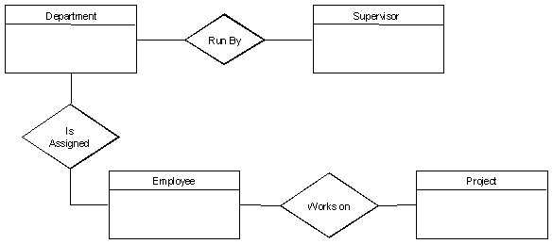
3. Draw Rough ERD
Objective: Put entities in rectangles and relationships on line segments
connecting the entities

Slide 23
4. Fill in Cardinality
Objective: Determine the number of occurrences of one entity for a single
occurrence of the related entity
A company has several departments.
Each department has a supervisor and at least one employee. Employees must be assigned to at least one, but possibly more departments.
At least one employee is assigned to a project, but an employee may be on vacation and not assigned to any projects.
    From the description of the problem:
    Each Department has exactly one Supervisor
    A Supervisor is in charge of one and only one Department
    Each Department is assigned to at least one Employee
    Each Employee works for at least one Department
    Each Project has at least one Employee working on it
    An Employee is assigned to 0 or more project

Slide 24
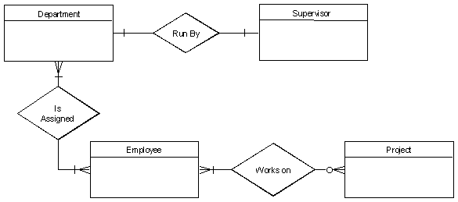
4. Fill in Cardinality
    From the description of the problem:
    Each Department has exactly one Supervisor
    A Supervisor is in charge of one and only one Department
    Each Department is assigned to at least one Employee
    Each Employee works for at least one Department
    Each Project has at least one Employee working on it
    An Employee is assigned to 0 or more project

Slide 25
5. Define Primary Keys
A company has several departments.
Each department has a supervisor and at least one employee. Employees must be assigned to at least one, but possibly more departments.
At least one employee is assigned to a project, but an employee may be on vacation and not assigned to any projects.
The important data fields are the names of the departments, projects, supervisors, and employees, as well as, the supervisor numbers, employee numbers and project numbers.
The Primary keys are
    Department name
    Supervisor number
    Employee number
    Project number

Slide 26
6. Draw Key-based ERD
Objective: Eliminate many-to-many relationship and include primary and
foreign key in each entity

Slide 27
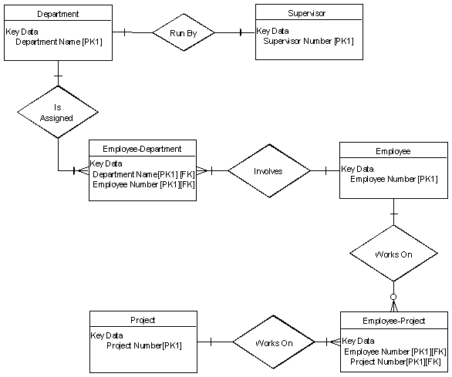
6. Draw Key-based ERD

Slide 28
7. Identify Attributes
Objective: Name the information details (fields), which are essential to the
system under development
The only attributes indicated are the names of
A company has several departments.
Each department has a supervisor and at least one employee. Employees must be assigned to at least one, but possibly more departments.
At least one employee is assigned to a project, but an employee may be on vacation and not assigned to any projects.
The important data fields are the names of the departments, projects, supervisors, and employees, as well as, the supervisor numbers, employee numbers and project numbers.

Slide 29
8. Map Attributes
Objective: For each attribute, match it with exactly one entity that it describes

Slide 30
9. Draw Fully Attributed ERD
Objective: Adjust the ERD from Step 6 to account for entities or relationships
discovered in Step 8.

Slide 31

9. Draw Fully Attributed ERD

Slide 32
10. Draw Fully Attributed ERD
Objective: Does the final ERD accurately depict the system data?
The Final ERD appears to model the data in this system well.

Slide 33
Data Dictionary Sample
An example for a Banking System

Slide 34
Data Dictionary Sample
An example for a Banking System
Stored entries of the corresponding DD (Account)
Account = | {@AccountNo + AccountType + Balance + CustomerNo} /* Storing balance information of an account */
AccountNo = | 9(10) /*Unique bank account number */
AccountType = | [Savings, Current, Recurring, STD]
Balance = | Float /* Precise up to decimal points */

Slide 35
Data Dictionary Sample
An example for a Banking System
Stored entries of the corresponding DD (Customer)
Customer = | {@CustomerNo + Name + Gender + PAN + Address + Telephone } /* Customer personal data */
CustmerNo = | 9(8) /* Unique customer identity number */
Name = | FirstName + (MiddleName) + LastName
FirstName = | {Characters, length : 18}
LastName = | {Characters, length : 18}
MiddleName = | {Characters, length : 18}
Characters = | {A-Z, a-z,0-9,’,-}
PAN = | X(10) /*Personal Account Number */
Gender = | [Male, Female]
Address = | /* Customer address, Length: 60 */
Telephone = | 9(10) /* Customer’s telephone number */

Slide 36
Data Dictionary Sample
An example for a Banking System
Stored entries of the corresponding DD (Transaction)
Transaction = | {@TransactionNo + Date + TType + Amount + (TPAccount) } /* Transaction record of each banking */
TransactionNo = | 9(12) /* A unique transaction number */
TType = | [Deposit, Withdrwal, Transfer] /* Transaction Type */
TPAccount = | AccountNo /* Third party account involved in a transaction */
Balance = | Float /* Precise up to decimal points */
Date = | /* Format : dd/mm/yyyy */

Slide 37
Problems to Ponder
Manual data dictionary vs. automatic data dictionary (in CASE)

